Slide 1
The statistical learning framework
by Botond Kovács

Slide 2
What do we need?
A domain set:
A label set:
A training set/data:
for example: {0, 1}
from

Slide 3

What do we want?
A prediction rule (predictor/hypothesis/classifier)
We assume that there exists a correct labelingfunction
A measure about how well it performs
Our data is generated from an unknown probability distribution over
The error of the prediction = true error of h = risk of h = generalization error:
We can only approximate this: training error = empirical risk = empirical error:

Slide 4
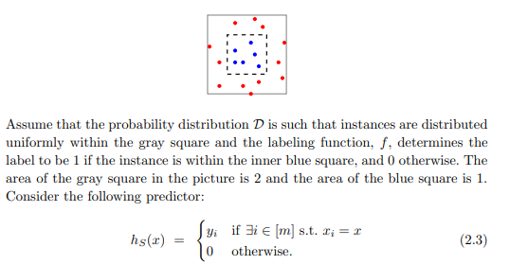
Overfitting
Our model may perform well on the training data, but poorly on the whole population
Example:

Slide 5
Inductive bias
A solution against overfitting
Let’s restrict the set of possible predictors
In general it is not guaranteed
If we restrict our set of models as a finite set and we have sufficient data, avoiding overfitting is guaranteed

Slide 6
Thank you for the attention!

